Slide 1
ASKE Use Cases (2)
Andrew Crapo
Narendra Joshi
Nurali Virani
Varish Mulwad

Slide 2
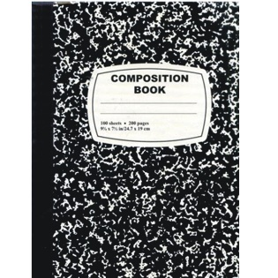
Knowledge Retention and Curation
ASKE
Learn new abstractions
Evolutionary trends
Scaling
Relationships between variables
Non-dimensional groupings
Bayesian Hybrid models
Models of physical significance
Uncertainty quantification
Underlying physical principles
Equations and description in text and engineering code (typically in FORTRAN/BASIC..)
Expert curated
PROGRAM B
Graphical representation of variables: XY plots, Area plots…
Expert curated
Challenge: Correlation is not causation
Expert curation required to make proper assessment
Design notebooks
Technical Manuals
Technical Bulletins
Field Manuals
…
Knowledge retention is a key challenge of US industry. Expert curation of documentation will enable retention of knowledge and avoid costly re-learning of lessons
Notes:
This Photo by Unknown Author is licensed under CC BY-SA-NC

Slide 3
Higher Level of Abstraction and Inference
ASKE
Learn new abstractions
Evolutionary trends
Scaling
Relationships between variables
Non-dimensional groupings
Bayesian Hybrid models
Models of physical significance
Uncertainty quantification
Underlying physical principles
Equations and description in text and engineering code (typically in FORTRAN/BASIC..)
Expert curated
PROGRAM B
Graphical representation of variables: XY plots, Area plots…
Expert curated
Published Literature,
Internal Reports,
Technical Reports,
Design review reports
Documentation
Enables :
tracking of evolutionary trends,
identifying hidden relationships,
subtle physical principles.
Notes:
This Photo by Unknown Author is licensed under CC BY-SA-NC

